Slide 1

https://www.uni-goettingen.de/en/48115.html
Unless I explicitly state otherwise, images and cartoons are created using ChatGPT.
You may use this material free of charge under the terms of the CC BY license. This requires that you provide appropriate attribution to the author: W. Link, University of Goettingen, Germany.
In a few cases, individual images, photographs, or similar material may be subject to a more restrictive Creative Commons license. Where this applies, it is explicitly indicated, and you must comply with the stated license terms for those items.
Please check the license information carefully before reuse. Responsibility for complying with the applicable license terms rests entirely with you.
PopGen_Ch-5
Population Genetics; Drift II
1

Slide 2
Sequential Number: #6
UNPLAB-PopGen_Ch-5[Drift II]
2

Slide 3
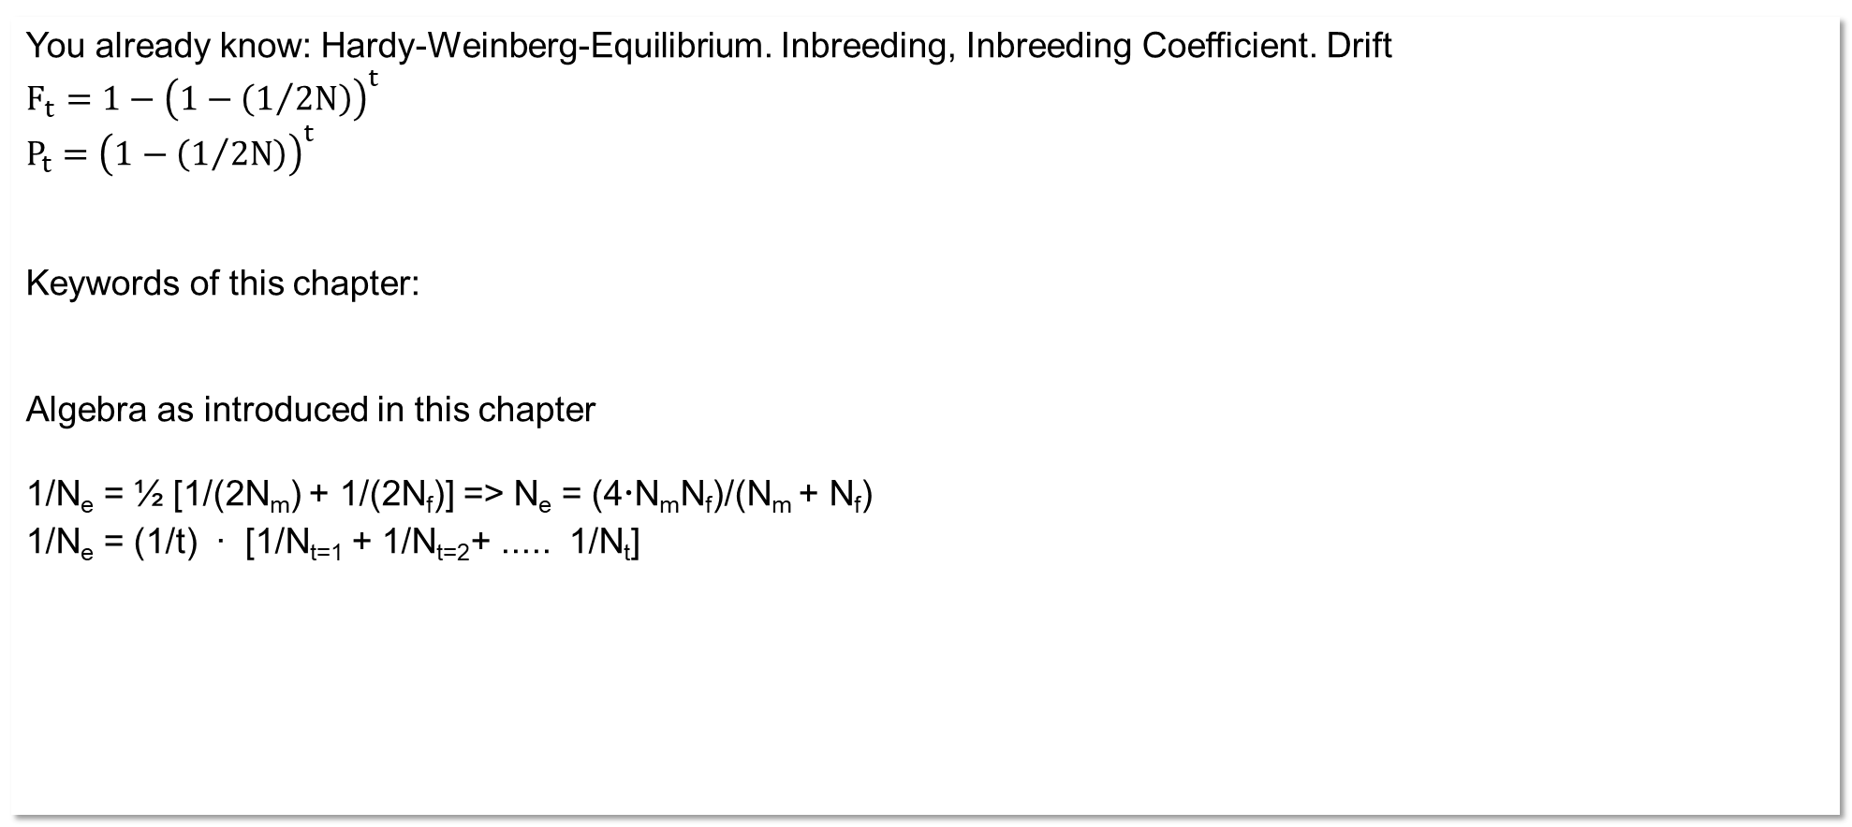
You already know: Hardy-Weinberg-Equilibrium. Inbreeding, Inbreeding Coefficient. Drift
$${F_{t}=1−\left(1−\left(1/{2N}\right)\right)}^{t}$$
${P_{t}=\left(1−\left(1/{2N}\right)\right)}^{t}$
Keywords of this chapter:
Algebra as introduced in this chapter
1/N_{e} = ½ [1/(2N_{m}) + 1/(2N_{f})] => N_{e} = (4N_{m}N_{f})/(N_{m} + N_{f})
1/N_{e} = (1/t) ∙ [1/N_{t=1} + 1/N_{t=2}+ ..... 1/N_{t}]
Decrease of heterozygosity |  | Risk of allele loss
H₁ = [1 - 1/(2N_{e})]H₀ |  | P=p^{2N}+q^{2N}
3

Slide 4
Non-random Mating, Migration, Mutation, Selection and Drift are ‘forces’ which cause a Population to deviate from the anchor-setting of the so-called
Hardy-Weinberg-Equilibrium.
The effects of Drift (Random Drift) on a ‚small‘ population can be told
as increase of Inbreeding since Drift started to act or (and)
as random deviation of allele frequency from the initial frequency.
4

Slide 5
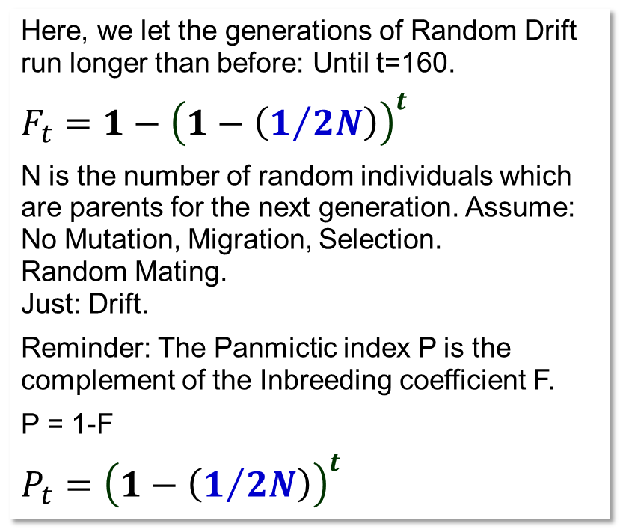
Genetic Drift* can be studied from the perspective of ‘increase of Inbreeding’.
Dear folks, remember: we're dealing with diploids here – this is why ... ‘1/2N’.
1.0
N=2
0.8
N=5
Here, we let the generations of Random Drift run longer than before: Until t=160.
$${F_{t}=1−\left(1−\left(1/{2N}\right)\right)}^{t}$$
N is the number of random individuals which are parents for the next generation. Assume:
No Mutation, Migration, Selection.
Random Mating.
Just: Drift.
Reminder: The Panmictic index P is the complement of the Inbreeding coefficient F.
P = 1-F
${P_{t}=\left(1−\left(1/{2N}\right)\right)}^{t}$
N=10
N=50
0.6
N=100
Inbreeding coefficient F
0.4
0.2
0.0
0
20
40
60
80
100
120
140
160
Generations of Random Drift
5
Genetic Drift*, as it is a non-steered, random process, may be called Random (Genetic) Drift. You knew it, true?

Slide 6
N=10; p₀(A1)=0.5. General expectation about Inbreeding and Probability to get fixed.
1.0
At t=24:.
F_{t=24} = 0.7080
Prob. of fix._{t=24} =0.5969
At t=100:.
F_{t=100} = 0.9941.
Prob. of fix._{t=100} = 0.9838.
1.0
Eight of the 16 simulated popula-tions (cf. UNPLAB-PopGen_Ch-4[Drift I]) indeed became mono-morphic at our focal locus within the first 24 generations. On average, 60% (about 10 in 16) are expected to become monomorphic (fixed) by then. I did not find algebra for this hence simulated 3200 populations and I present these results here as expected results (Probability of ... being fixed).
After 100 generations, more than 98% of all populations are expec-tedly fixed for either allele and the average inbreeding coefficient across all (N=∞) small popula-tions is then F₁₀₀= 0.9941.
0.8
0.8
0.6
0.6
Expected inbreeding coefficient F_{t}
Prob. of fix. / Inbreeding
0.4
0.4
Probability of random population being fixed
0.2
0.2
0.0
0
5
10
15
20
24
Generations 0 < t < 24
6

Slide 7
N=10; p₀(A1)=0.5. Longer perspective (t=160 generations of Drift).
N=10 p=0.5
1.0
0.9
0.8
0.7
0.6
The probability that a randomly taken small population is fixed for either allele increases fast.
At t=20, it is already 50.75%
At t=40, it is 82.6%,
At t=80 it is 97.8%,
At t=100 it is 98,38%,
At t=160 it is more than 99.9%.
Prob. of fix. / Inbreeding Coeff.
0.5
Probability of random population being fixed
0.4
Inbreeding coefficient F
0.3
0.2
0.1
0.0
0
20
40
60
80
100
120
140
160
Generations, 0 ≤ t ≤ 160
7

Slide 8
A longer perspective, across 160 generations of Drift, still N=10 and p₀=0.5 (p at t=0).
8
The distribution, here based on 3200 simulated small populations, be-comes soon shaped like letter U.
We see most of the populations assembled near to the allele fre-quencies 0 or 1. The longer Drift runs, the less frequent are populations with intermediate allele frequencies.
Interestingly, populations with intermediate allele frequencies as 0.1 ≤ p(A1) ≤ 0.9 are quite evenly distributed across these 8 classes on our scale. In generation 20, we have from 149 to 191 populations per intermediate frequency class, i.e. about 5% of the small populations per class. In generation 40, it is about 2% per class, in generation 80, it is 0.25% per class (from 6 to 12 small populations). The picture is: Since Drift is unavoidable in nature and in breeding, probably intermediate allele frequencies are rather rarely realized and cases with minority alleles and even fixation of either allele are not unusual. Mutation and Selection will not change much of this general picture.

Slide 9
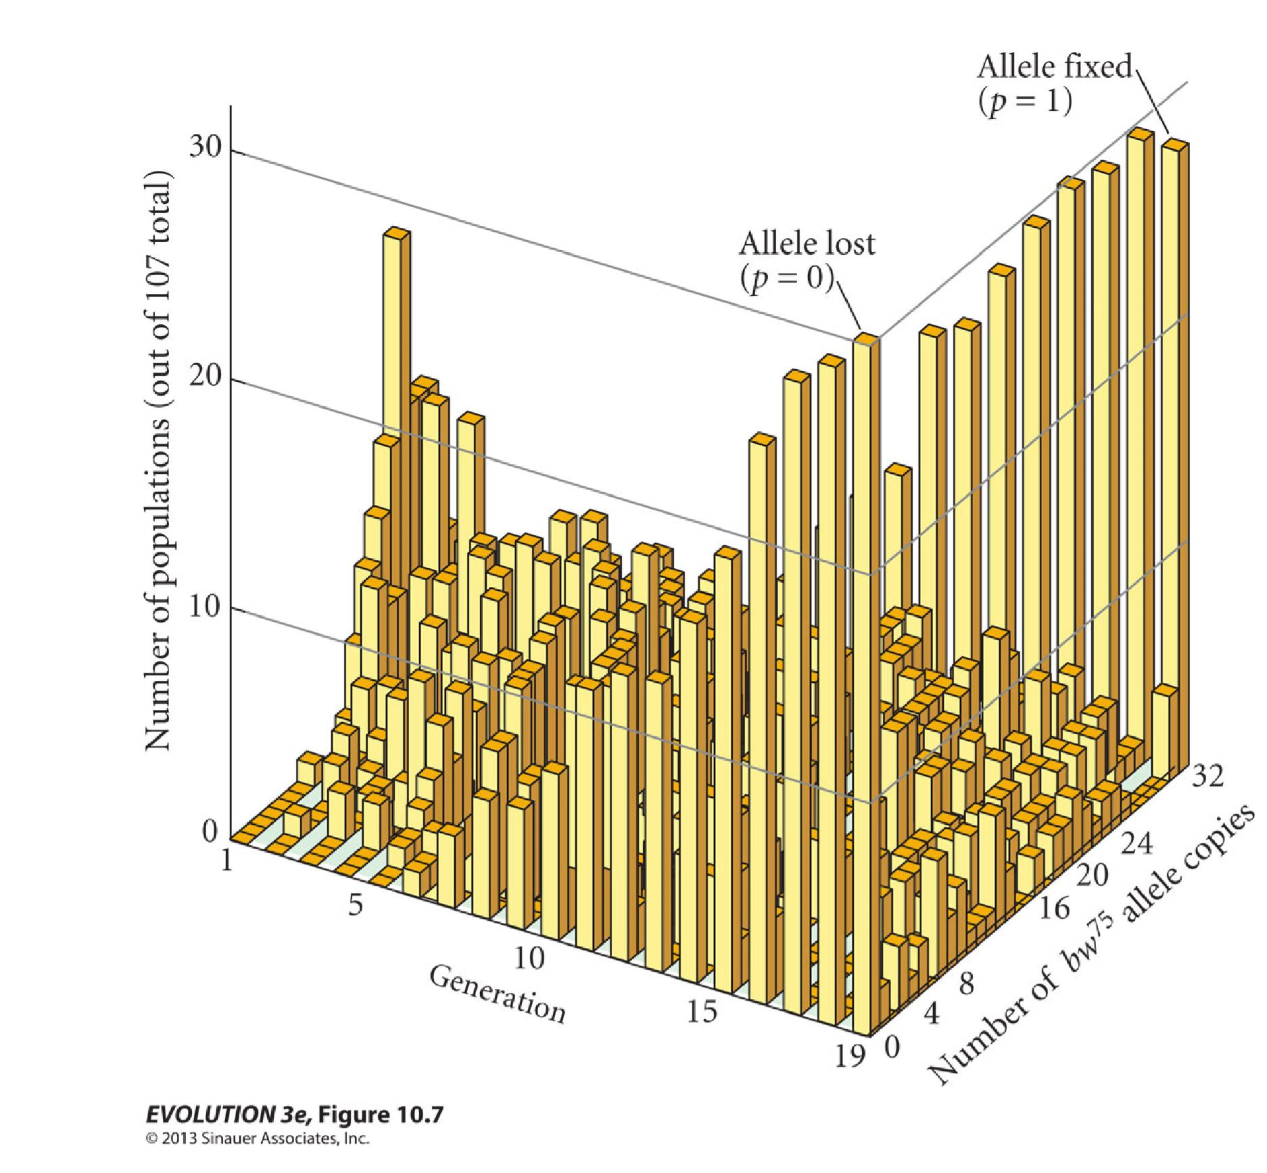
Same; just with results from a lab experiment (with Drosophila flies).
Allele fixed (p=1)
Random Genetic Drift in 107 independent, small populations of Drosophila melanogaster. Each of the 107 populations consisted of N=16 „bw⁷⁵“/“bw“ heterozygous individuals. From eight males and eight females, you get an endless large number of offspring individuals – from which again (randomly) eight males plus eight females were taken per population to be parents of the next generation of this population etc..
After five generations of Random Drift, the first of the 107 populations became fixed for the one or other allele (see arrow). Red caps show the columns which number the populations that lost the bw⁷⁵ allele. The number of not-yet-fixed populations decreases with generation number. Ultimately, there is a fairly even distribution for allele number among the (few) not-yet-fixed popula-tions.
After Hartl and Clark, 1997
based on: Buri, 1956. Evolution 10: 367–402
Allele lost (p=0)
Nulmber of populations (out of N=107)
Number of bw⁷⁵
alleles
Generation
EVOLUTION 3e, Figure 10.7
© 2013 Sinauer Associates
9

Slide 10
Drift can be seen from the inbreeding-side and from the variance-side.
σ²=pq/(2N) which is σ²=pq/n (‚Bernoulli‘). It takes 2 gametes to make 1 offspring. Here, p=p₀=p_{initial}= 0.5.
The longer (the more generations) the small popu-lations follow their Drift-influenced ‘fate’, the more of them become homozygous for the one or the other allele (p=1 or p=0).
► Homozygosity increases; Inbreeding increases
And: The more they differ from each other! The vari-ance between them for their frequency of allele bw⁷⁵ increases. After one generation, σ² = pq/(2N).
In the end,
σ²=pq (as half of them p=1 and half with p=0).
► Variance between replicated, small populations increases
What we see here for one locus happens for all (unlinked) loci. Several small population may be fixed for allele A1 at this locus. But: each of them is independent for becoming ultimately fixed for “B1 or B2”, for “C1 or C2”, and so on. By and by, replicated small populations become more and more different from each other.
Allele fixed (p=1)
Allele lost (p=0)
Nulmber of populations (out of N=107)
Number of bw⁷⁵
alleles
Generation
10

Slide 11
Drift can be seen from the inbreeding-side and from the variance-side.
Allele fixed (p=1)
Allele lost (p=0)
Take note that here, from the experimental data, you can see the U-shaped distribution of allele frequencies of replicated small populations, already after few such as 15-19 generations of Random Drift.
Nulmber of populations (out of N=107)
Number of bw⁷⁵
alleles
Generation
EVOLUTION 3e, Figure 10.7
© 1013 Sinauer Association, Inc.
11

Slide 12
A populations that suffers for several generations from exactly the same „Drift“ ... a bit unrealistic.
„How many of the currently living individuals will be parents for the next generation?“
It is unrealistic to assume that – in a real case - we see exactly the same fixed number N in each generation.
There is more that may not be ‘ideal and simple’. Maybe plants are not herm-aphrodite, but male and female are separated (dioecious, such as in hemp, Cannabis sativa); maybe number of males and of females which mate are different.
To tackle with such hazards and to still be able to use our simple algebra, we define N_{e}, which is the “effective population size”.
12

Slide 13
We define N_{e}, which is the “effective population size”.
I tend to say: The “effective population size N_{e}” of a real population equals the population size N of an ideal population that shows the same amount of Drift as occurring in the real population.
Holsinger* says: „The “effective size of a population N_{e}” is the size of an ideal population that has the same properties with respect to genetic drift as our actual population does.“
“?” Well... If your actual population is not N=∞, but the census number is N=500, yet the inbreeding due to Drift is more than expected; if actual Drift is hard as if N=4, then the effective size of your population with respect to Drift is N_{e} = 4.
*Kent Holsinger. https://darwin.eeb.uconn.edu
13

Slide 14
Effective population size in cases with different numbers of male and female individuals
The effective population size derives from the harmonic mean.
1/N_{e} = ½ [1/(2N_{m}) + 1/(2N_{f})] => N_{e} = (4N_{m}N_{f})/(N_{m} + N_{f})
With e.g. N_{m}=2 for males and very many females, there is as much Drift to be expected as in a population with N=8 and monoecious flowers (or equal numbers males and females if species is dioecious).
Thus, the effective population size is much restricted if the numbers are small in one sex. This applies to some extent to the cattle breeding situation.
One (e.g. male) genotype (individual) mated to very many others results in one big half-sib family. A half-sib family is genetically as narrow as a population founded by N=4 unrelated (non-inbred) individuals. With 2 or 4 males and very many females, the offspring is as ‘wide’ as with 2 or 4 such half-sib families, hence as with 8 or 16 founders.
If autosomal genetics is considered, it does not matter whether the bottleneck is via male or female side.
16
14
4 male parents
12
10
= effective population size
8
2 male parents
6
4
N
e
2
0
0
10
20
30
40
50
60
70
80
90
100
Number of females parents
● Inbreeding by half-sib mating results in F= 1/8.
● A randomly mating population, initiated from 8 unre-lated homozygotes, realizes F=1/8. A group of 8 unrel-ated homozygotes is as ‘wide’ as a group of 4 unrelated (non-inbred) members from the HWE popul.
14

Slide 15

You may just jump and omit the next two pages.
You may study the next two pages;
if you are really interested and keen to get things … really :-)
15

Slide 16
To ponder about N_{e} and inbreeding if N=1 individual mates with N=∞ individuals
Inbreeding by half-sib mating results in F= 1/8. You see here why and how.
The [A1A3;A1A4;A2A3; A2A4] represent the first half sib, coming from A1A2 x A3A4. Three further half sib-lings are shown. The common parent makes F=1/8 in each mating between two half siblings. Their N=∞ private parents (A3A4, A5A6, A111A112, A113A114, ...) do not share common (‘ibd’) alleles thus don’t cause inbreeding
:-)
The number of alleles per locus is of course not really N=∞. But writing it like this, we directly filter-out all homozygosity which is just ‚alike in state‘; which is just because two private parents (such as AxA4 and AxA6) happen to have the same allele x without this being ‚identical by descent‘. Writing it with N=∞ alleles allows to equate the resulting percentage of homozygosity with the inbreeding coefficient F.
16

Slide 17
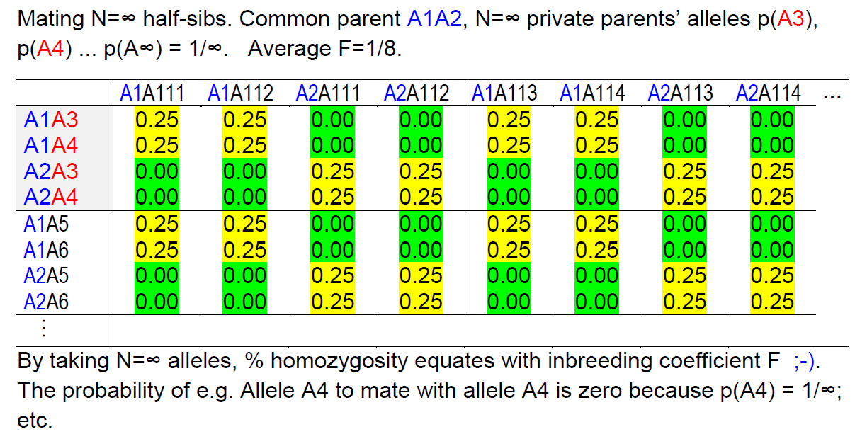
Compare N_{e} if (1) N=1 individual mate with N=∞ and if (2) N=4 individuals mate
Again: We compare the bottle-neck of
“1 mates with N=∞” with
the bottle neck of
“four mate at random”.
We come to the same value of F=1/8; you see how.
Although both cases yield an inbreeding coefficient of F=1/8, they differ substantially in a broader sense. In the first case, there is an unlimited number of alleles and thus high genetic diversity. In the second case, however, there are only N=8 alleles, representing a much more restricted level of diversity by comparison. Relying solely on the inbreeding coefficient F does not tell the whole story ;-)
17

Slide 18
N=162
On the next page, we study a se-quence of ten generations and nine of them had the same, large population size, N=162. But one generation suffered from a heavy bottle neck with N=2.
This causes Drift. How large (in terms of N) should an Ideal Popu-ation be to cause the same Drift as our non-ideal population here?
Of course: Random Mating, no Selection, no Migration, no Mutation. Just Drift. Drift alone.
And: For our purpose it does not matter when the bottleneck occurs, early or not so early or late in the sequence of the ten generations.
Think abut this ;-) !
N=2
1 Generations 1 to 10 10
18

Slide 19
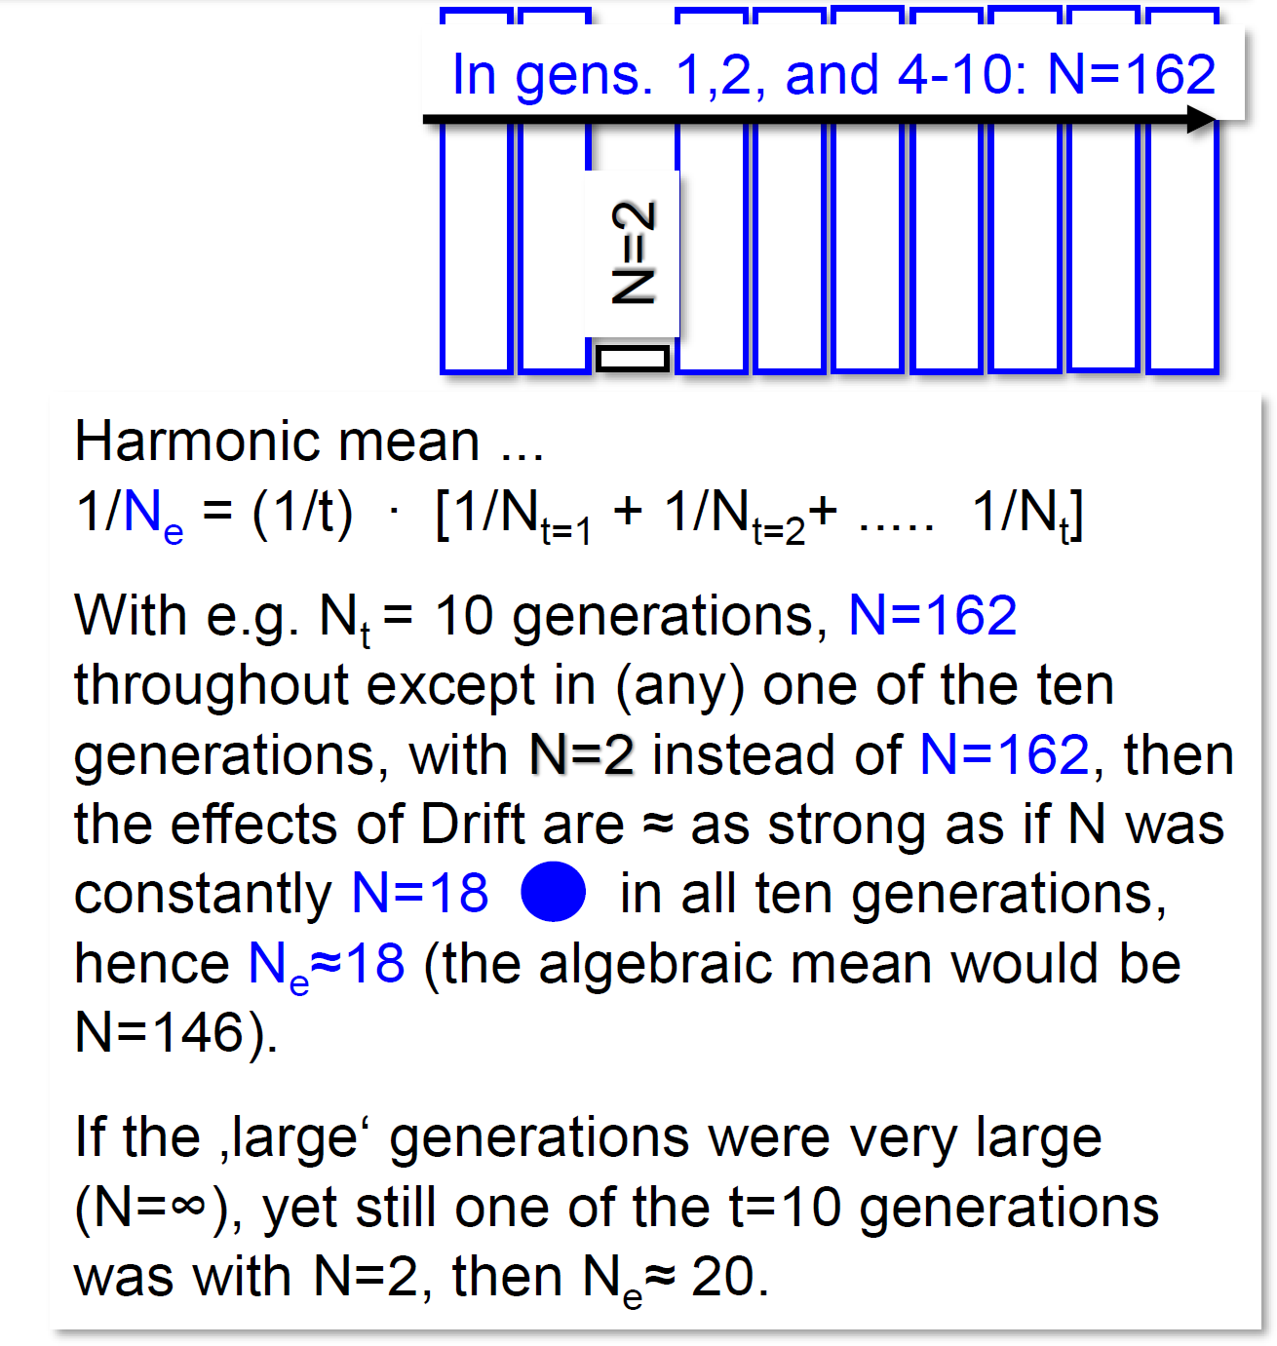
19
Effective population size in cases with different numbers N per t generation.
40
4 individuals for one generation
36
The effective population size derives from the harmonic mean.
1/N_{e} = (1/t) ∙ [1/N_{t=1} + 1/N_{t=2}+ ..... 1/N_{t}]
With e.g. N_{t} = 10 generations to be considered, and with N=162 throughout except in one of the ten generations, when N=2 instead of N=162 was true, then the effects of Drift are as strong as if N was constantly N=18 in all ten generations, hence N_{e}=18 (the algebraic mean would be N=146).
If the ‚large‘ generations were very large (N=∞), yet still one of the t=10 generations was with N=2, then N_{e}=20.
32
28
24
= effective population size
2 individuals for one generation
20
18
16
12
e
8
Effective population size if in a sequence of
N
ten generations the ‚normal‘, constant population
4
size is small (N=2; N=4) for just one generation.
0
0
25
50
75
100
125
150
175
200
‚Normal‘ population size
162
Alleles being lost in the bottleneck generation (N=2) cannot be brought back by later larger N (no Mutation no Migration). This describes the important Founder Effect in Evolution.

Slide 20
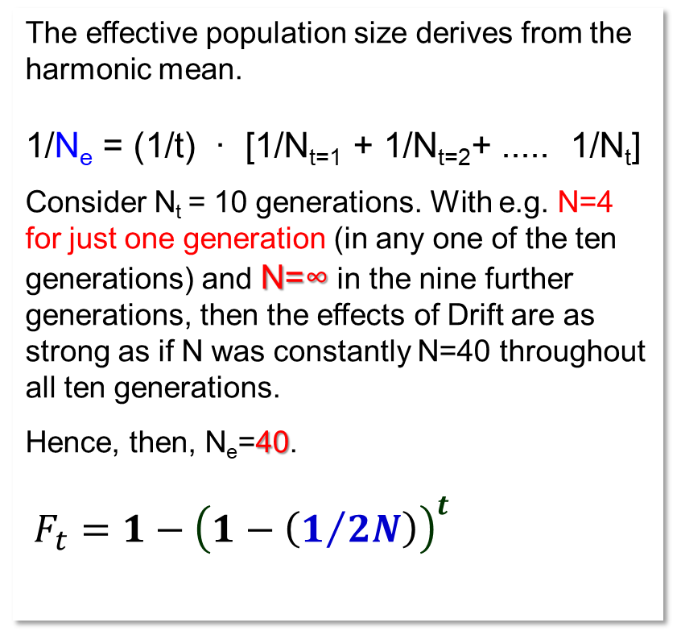
Effective population size in cases with different numbers N per t generations.
40
4 individuals for one generation
36
The effective population size derives from the harmonic mean.
1/N_{e} = (1/t) ∙ [1/N_{t=1} + 1/N_{t=2}+ ..... 1/N_{t}]
Consider N_{t} = 10 generations. With e.g. N=4 for just one generation (in any one of the ten generations) and N=∞ in the nine further generations, then the effects of Drift are as strong as if N was constantly N=40 throughout all ten generations.
Hence, then, N_{e}=40.
${F_{t}=1−\left(1−\left(1/{2N}\right)\right)}^{t}$
32
28
24
= Effective Population Size
2 individuals for one generation
20
N_{e}=18
16
12
e
8
Effective population size if in a sequence of
N
ten generations the ‚normal‘, constant population
4
size is very small (N=2; N=4)) for one generation.
0
0
25
50
75
100
125
150
175
200
‚Normal‘ Population Size
162
Again! ... The bottleneck is N=4, and the ‘Normal’ population size N=∞ here instead of N=162.; then N_{e}=40.
If the bottleneck was N=2 (and otherwise nine times N=2), then we find N_{e}=20.
20

Slide 21
Random mating in a small population with e.g. N=3 individuals (parents for next generation) means automatically that 1/3 of all mating is actual self-fertilization. Random is “random”; selfing is one of the three random options for individual #1:
(1) #1 as mating partner, (2) #2 as mating partner, (3) #3 as mating partner.
Since Drift and its consequences are related to inbreeding and its consequences, you may conclude that – if one could avoid actual self-fertilization in a small population – then Drift-consequences should be much reduced.
Actual self-fertilization can indeed be avoided.
Mechanism are e.g. Protandry, Protogyny, self-incompatibility.
DOI 10.1002/j.1537-2197.1993.tb13840.x
Will this idea work ?
21

Slide 22
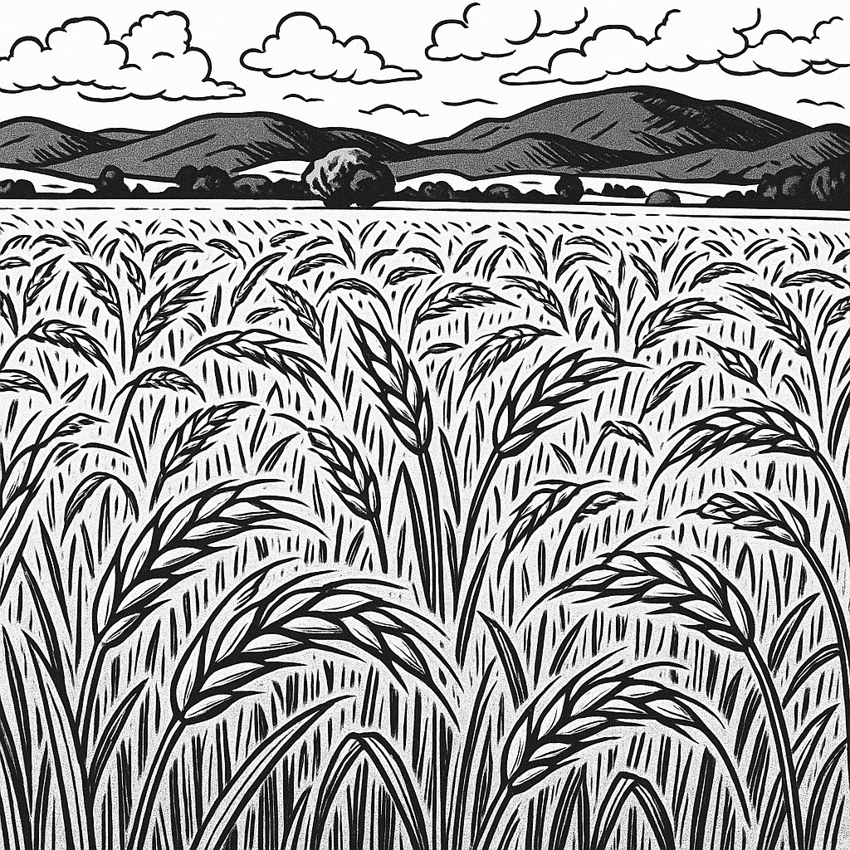
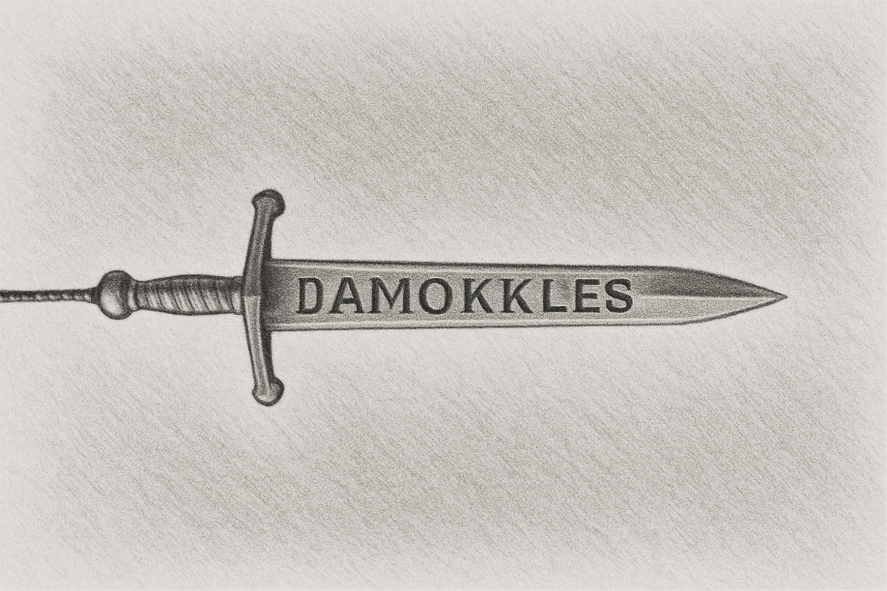
Effective population size (thus ‘amount’ of Drift) if actual Self-Fertilization is avoided.
Secale cereale is usually self-incompatible (SI). Its gametophytic SI system is based on two loci (DOI 10.1007/s00122-004-1869-4). For hybrid breeding, self-com-patible rye was developed (yet, still wind-pollinated).
If self-fertilization is excluded,
N_{e} = (approx.) N + 0.5
If sib-mating is excluded,
N_{e} = (approx.) N + 2
Our rye population.
Wrong spelling by ChatGPT
22

Slide 23
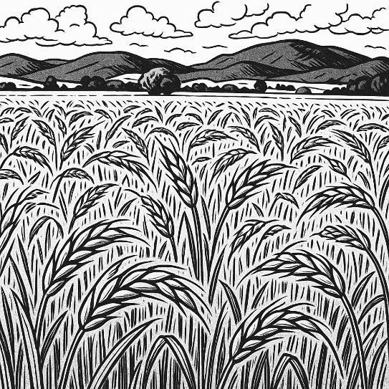
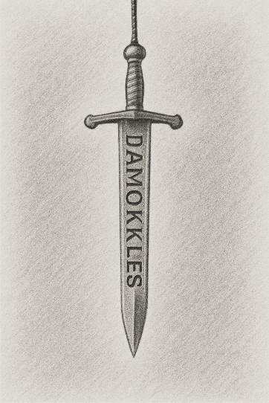
Effective population size if actual self-fertilization is avoided.
Secale cereale is usually self-incompatible (SI). Its gametophytic SI system is based on two loci (DOI 10.1007/s00122-004-1869-4). For hybrid breeding, self-com-patible rye was developed (yet, still wind-pollinated).
Create two rye populations, (A) and (B), both from mixing N=2 homozygous genotypes (then Random Mating; no further Drift). The first reproduction is for (A) avoiding actual Selfing and for (B) strict random, thus including Selfing.
The direct offspring of the initial mixture holds only F1 plants, zero Inbreeding (Selfing was avoided!). Yet, in the next propagation, the sword of Damocles (the Inbreeding) strikes relentlessly: now, only one genotype exists, and all presumed random ;-) ! ... mating is actual Selfing, the offspring is F2 and thus is half-inbred (and will not recover from this value F=0.5 in further generations).
The direct offspring of the mixture will be composed of 50% of F1 plants, 25% of plants which are selfs of the first and 25% selfs of the second ancestral line (average inbreeding now: F = 0.25∙1 + 0.5∙0 + 0.25∙1 = 0.5). In future generations, average F stays at F=0.5; yet, inbreeding of individuals will vary less. Variance for the inbreeding coefficient of individuals in population will be σ²_{t} = (1/4)^{t} (after t generations random mating). For instance, after t=3 gene-rations, 61% of all individuals already share F=0.5 (the others are at F=0.0 or 0.25 or 0.375 or 0.625 or 0.75 or 1.0).
Take home: Exclusion of Selfing (or sib-mating or the like) is as to Drift (nearly) no help, it is just postponement. Procrastination. ☺
If self-fertilization is excluded,
N_{e} = (approx.) N + 0.5
If sib-mating is excluded,
N_{e} = (approx.) N + 2
Our rye population. Now, created with N=2 ancestors.
23

Slide 24
A bit specific is this here. N_{e} is larger than N. Wow. Drift is smaller in reality than in theory, because N_{e} is larger than the census N. What? Really now? How?
If a population keeps constant in size, then – on average – each individual contributes 2 successful gametes to the next generation (two gametes make one individual). There is random variation for that number of successful gametes per individual. That variation follows the Poisson distribution. That distribution has it that ‘mean = variance’. Hence, here, with mean=2 successful gametes, the variance for the number of successful gametes per parental individual is σ²=2.
If the variance of the randomly varying number of offspring per parent is reduced to zero (always exactly 2 gametes per parent and 2 offspring per mating), then
N_{e} = (approx.) 2N – 1. ... this increase of N_{e} could be a temporary solution, at least.
The more pessimistic notion would be: Extinction occurs before the last individual dies: Because of loss of genetic diversity hence because of accumulation of Inbreeding Depression. If only few individuals exist, the species is probably lost ...
24

Slide 25
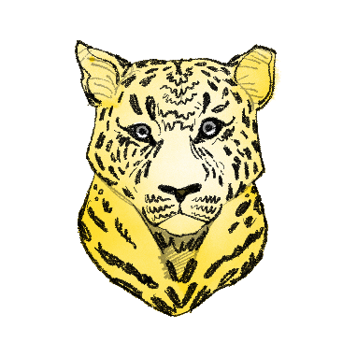
N_{e} = (approx.) 2N-1. The Asian Cheetah (Asiatischer Gepard; Acinonyx jubatus vanaticus is heavily threatened from extinction (wikipedia.org/wiki/cheetah)
25
Only few animals of the
Asian cheetah live in the wild
(in Iran; India starts to re-intro-
duce cheetahs into its wildlife,
yet with animals from Africa;
‘wrong’ sub-species). Assume
the animals cannot survive inbreeding higher than F=0.1 (genetic load).
The red curve shows the development across 12 generations with random mating and an assumed number of N=30 reproducing individuals / generation.
Already in generation 7, Drift-induced inbreeding would hence be lethal. But: If reproduction was organized such that the N=30 reproducing animals in each generations have the same (i.e. two per pair) number of successful offspring. N_{e}= 2N-1 = 59 (black curve). Then, even after 12 generations, inbreeding depression was just not yet lethal.
© HL
Of course this would not be the ultimate rescue. This would be a strategy to slow-down Drift, to gain time, so that the population can increase in numbers and ~stop Drift. The same – of course – applies to plant species.

Slide 26
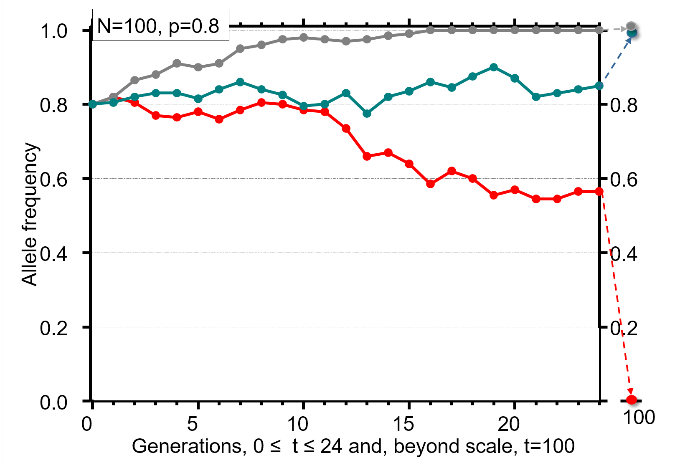
Check whether the concept of Random Drift became clear.
There are four genetic consequences of limitations of population size
Random Drift (literally). Random changes of allele frequency.
Allele frequencies in small populations change from generation to gene-
ration. They change in an erratic manner, and there is no tendency to
go back to the original frequency.
Differentiation between small populations. Random changes (Drift)
in several small populations occur independently. Hence, the small
populations become more and more different from each other.
Uniformity of small populations. Genetic variation between the individuals within a small population is going to be smaller and smaller, the individuals become genetically more and more similar to each other.
Increased homozygosity. Homozygous loci and homozygous individuals increase at the expense of heterozygous loci and individuals. This is the reason for the progressively reduced viability and fertility in small populations.
Drift can be studied from the point of view of Sampling or from the point of view of Inbreeding.
26
26

Slide 27
Further rehearsal and application
With N_{e}=100, reduction in heterozygosity in one generation is very small. Risk to lose either allele is about zero unless the minor allele frequencies is extremely small.
With N_{e}=10, reduction in heterozygosity is limited and risk to lose one of two alleles is only very small if allele frequencies are intermediate.
With N_{e}=2, all effects are marked and risk of allele loss is quite high.
If an allele went lost it was – usually – the minority allele, not the majority allele. This was clear anyway, wasn‘t it?
With N=2 and p(A)=0.8, risk to lose the frequent allele in one generation is P=0.16% whereas the probability P to lose the rare allele 0.8⁴ = P= 40.96%. This is the probability that you take the frequent one four times in a row, hence take the rare one zero times with the four gametes (with N=2 individuals as parents for next step).
27

Slide 28
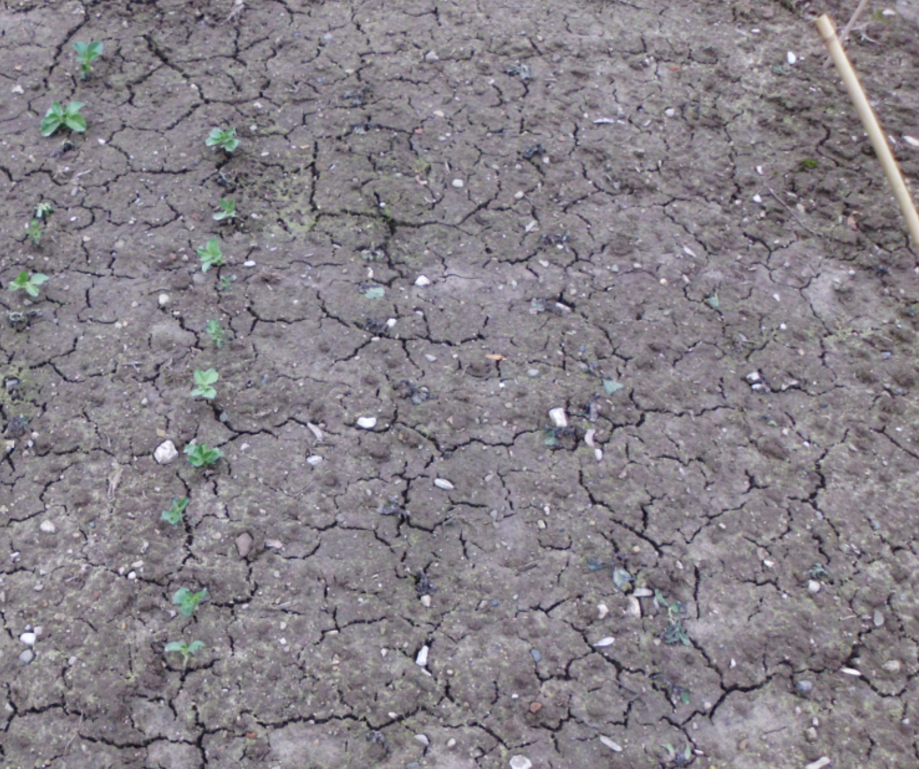
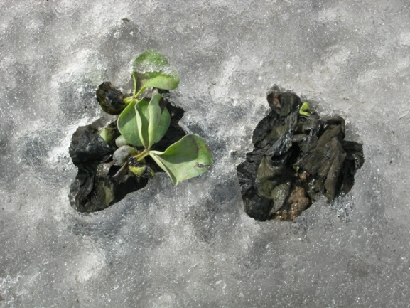
Breeding means selection, selection means restricted number of parents hence Drift.
The photo shows how, in a very harsh winter, winter faba bean plants died. Actually few plants of the population survived! Will their offspring …
be more winter-hardy than the unselected population… ?
Yes, very probably
contain all alleles that coded for better winter hardiness and existed in the unselected population?
No, very probably not.
contain all diversity for other traits such as fungus resistance and seed protein content etc. ?
No, quite surely not!
Selection and Drift occur simultaneously, therefore we can – even for the traits under selection – not be sure that none of the ‘good’ alleles will be lost.
© R. Martsch
28

Slide 29
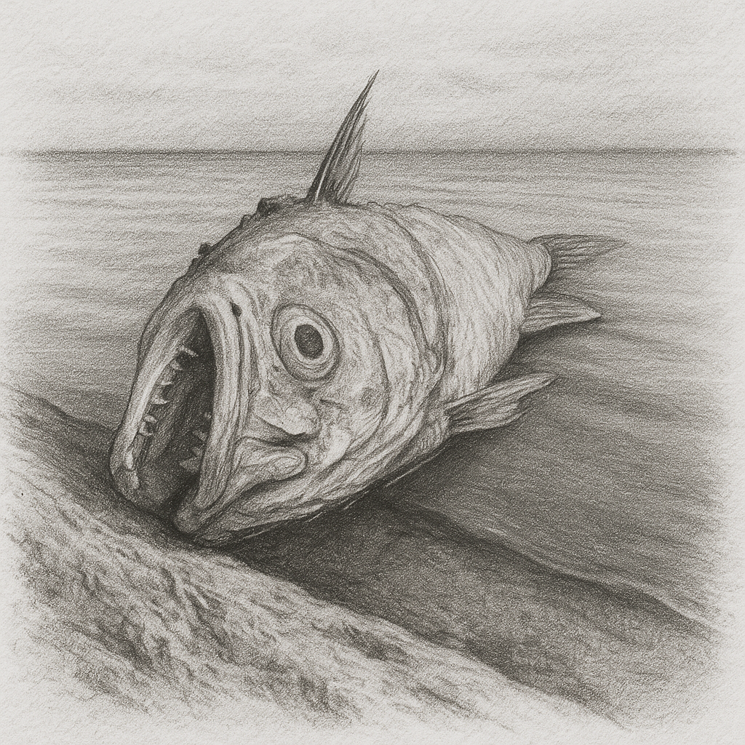
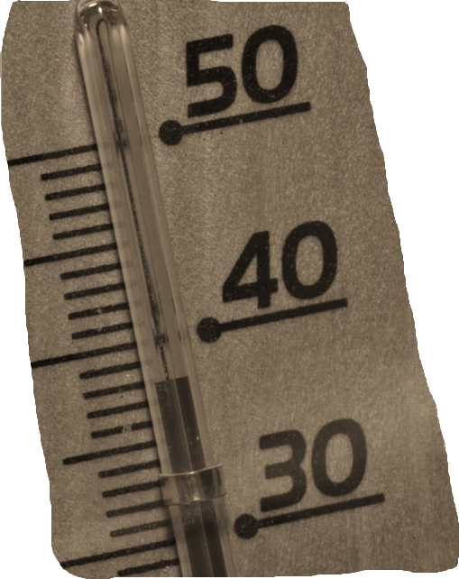
Breeding means selection, selection means restricted number of parents hence Drift.
The drawing shows how in August 2022 (very hot summer), pikes (Hechte; Esox lucius) died in the Oder river. Actually few individuals of the population survived! Will their offspring …
be more heat-hardy than the unselected population… ?
Yes, very probably
contain all alleles that coded for better heat-tolerance and existed in the unselected population?
No, very probably not.
contain all diversity for other traits such as parasite resistance and cold tolerance etc. ? No, quite surely not!
Selection and Drift occur simultaneously, therefore we can – even for the traits under selection – not be sure that none of the ‘good’ alleles will be lost.
29

Slide 30
From here you may go to UNPLAB-PopGen_Ch-6[Selection]
30
30

